Slide 1
01 FINAL PROJECT · STATISTICS II
Statistical Analysis of CICIDS 2017 Intrusion Data
Mapping normal traffic and isolating threats via multiple linear & logistic regression.
STATISTICS II · IDC 5205 · MAY 2026

Slide 2
SETUP · RESEARCH QUESTIONS
02 / 13
Defining the baseline and the threat.
We split the question in two: first describe normal network behavior, then learn what makes an attack look different.
DATASET TERRAIN
PHASE 1 · MLR
PHASE 2 · LOGISTIC
CICIDS 2017
Establish what's normal.
Catch the culprit.
SOURCE
TARGET
TARGET
Canadian Institute for Cybersecurity.
Benign traffic only.
All traffic — benign and attack.
SCOPE
QUESTION
QUESTION
79 columns describing packet sizes, timing, TCP flags, and routing.
Which network flow features best predict total byte volume (Flow.Bytes)?
Which features actually distinguish attack flows from benign ones?
SAMPLE
GOAL
GOAL
~250 rows drawn from each raw CSV across 8 days of traffic, cleaned to remove infinities and NAs.
Build a statistical baseline that captures the shape of normal traffic.
Identify the risk factors and classify each flow as benign or attack.
STATISTICAL ANALYSIS OF CICIDS2017 INTRUSION DATA
STATISTICS II · MAY 2026

Slide 3
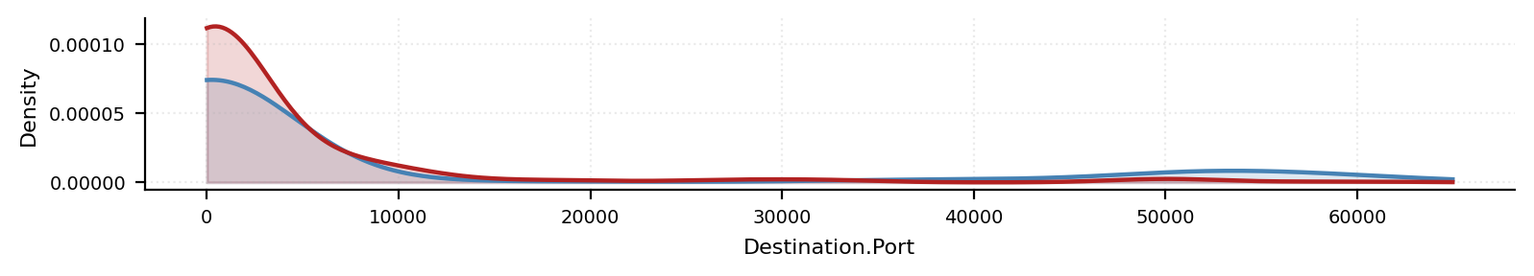
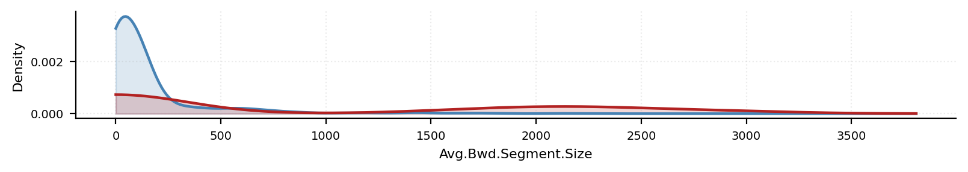
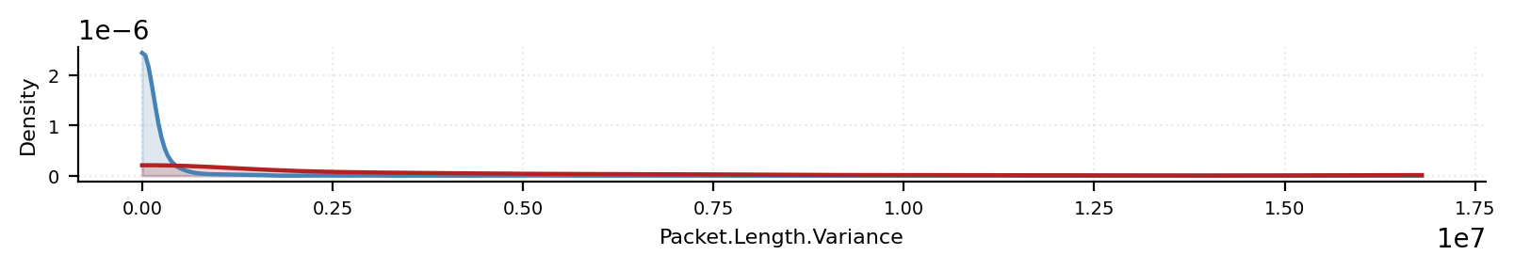
EXPLORATORY · DESCRIPTIVE STATISTICS
03 / 13
Attack traffic is highly dispersed.
Side-by-side densities of three key flow features.
Notice how tightly benign traffic clusters versus the scattered, heavy-tailed shape of attacks.
Density of Destination.Port
BENIGN
ATTACK
VISUAL FINDING
The benign curves are similar to the attack curves except for the left tails.
Density of Avg.Bwd.Segment.Size
BENIGN
ATTACK
KEY INSIGHT
To break in or flood a server, attackers must manipulate standard packet sizes and port usage . That manipulation leaves an observable statistical footprint — and that footprint is exactly what the next two models are built to read.
Density of Packet.Length.Variance
BENIGN
ATTACK
STATISTICAL ANALYSIS OF CICIDS2017 INTRUSION DATA
STATISTICS II · MAY 2026

Slide 4
EXPLORATORY · CATEGORICAL RISK
04 / 13
The port category anomaly — where attacks hide.
We mapped Destination.Port to the three IANA ranges, then measured how often each range carries an attack.
01
02
03
Dynamic Ports
Well-known Ports
Registered Ports
49152 – 65535
0 – 1023
1024 – 49151
95.8% benign
4.2% attack
82.7% benign
17.3% attack
55.6% benign
44.4% attack
Nearly half of all flows here are hostile.
A Chi-square test confirms a highly significant relationship between destination port category and attack status — the registered range is a real, statistical hot zone, not noise.
χ² = 135.83 df = 2 p < 2.22e-16
STATISTICAL ANALYSIS OF CICIDS2017 INTRUSION DATA
STATISTICS II · MAY 2026

Slide 5
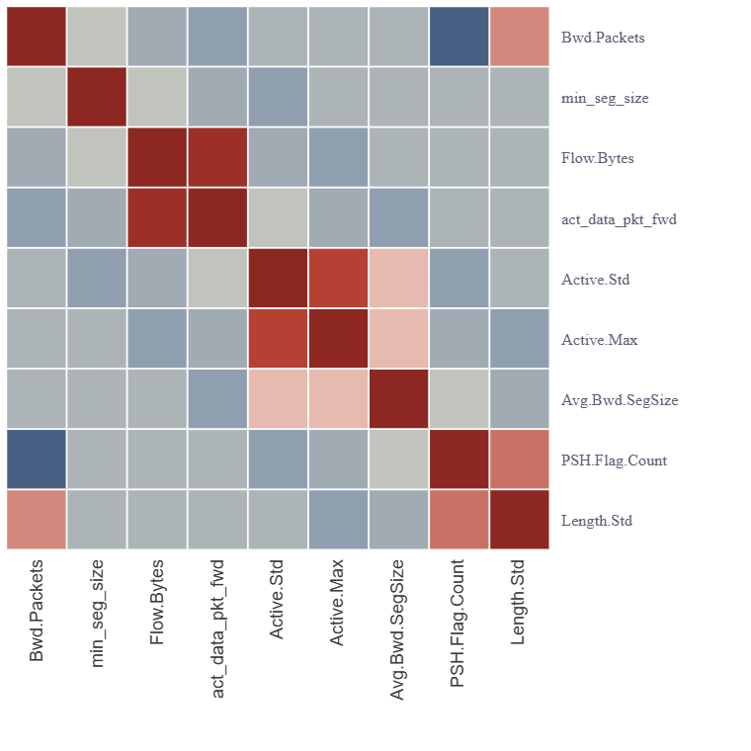
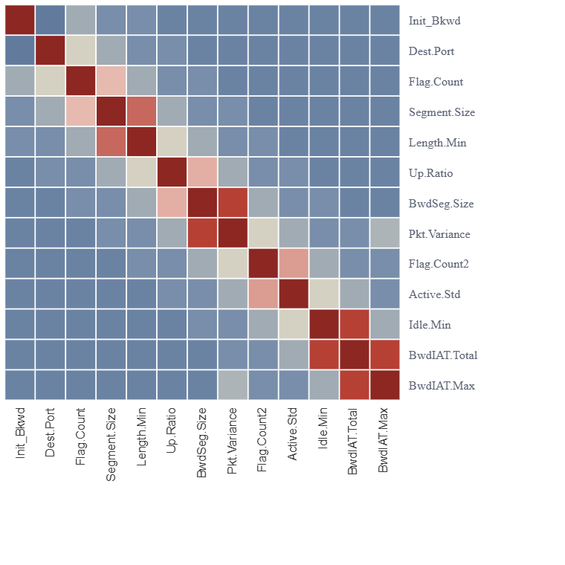
PRE-MODELING · VARIABLE SELECTION
05 / 13
Pruning the redundant predictors.
Before either model is fit, we screen the candidate predictors for multicollinearity.
Heavily redundant variables get cut by stepwise BIC
MLR Predictor Correlations
PHASE 1 · 9 VARS
Logistic Predictor Correlations
PHASE 2 · 13 VARS
−1
+1
−1
+1
OBSERVATION
ACTION
Both matrices show intense pockets of correlation (dark navy and firebrick red ), particularly among packet-size and length variables.
To keep the models stable, all highly correlated pairs (|r| > 0.9) were pruned before stepwise variable selection.
STATISTICAL ANALYSIS OF CICIDS2017 INTRUSION DATA
STATISTICS II · MAY 2026

Slide 6
PHASE 1 · MLR SETUP
06 / 13
Modeling the shape of normal traffic.
1
Model scope
MULTICOLLINEARITY CHECK · VIF
First-order terms only — no interactions or polynomial expansions. Keep the model interpretable.
# Variance Inflation Factor vif_values <- car::vif(mlr_model) print (vif_values)
## act_data_pkt_fwd PSH.Flag.Count Avg.Bwd.Segment.Size
## 1.720699 2.261688 5.937063
## Bwd.Packet.Length.Std Bwd.Packet.Length.Min min_seg_size_forward
## 6.830515 1.769534 1.038479
## Active.Std Active.Max
## 2.406375 2.545160
2
Variable selection
Stepwise BIC applied to the benign-only dataset to find the leanest predictor set.
✓
All clear. Max VIF is 6.83 , well below the standard threshold of 10. Our predictors are stable enough to interpret.
3
Result
8 predictors retained to model Flow.Bytes.
STATISTICAL ANALYSIS OF CICIDS2017 INTRUSION DATA
STATISTICS II · MAY 2026

Slide 7
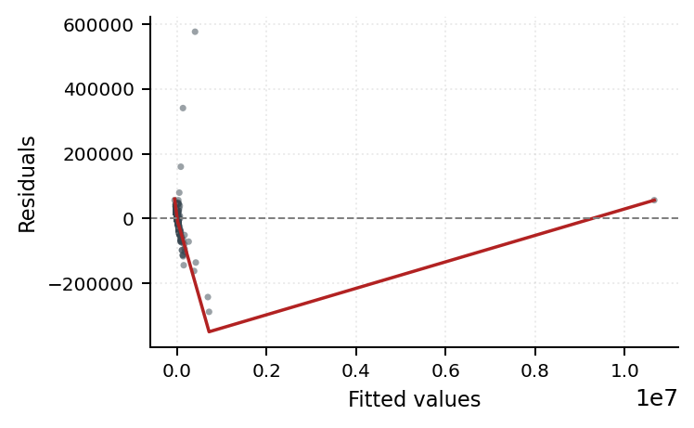
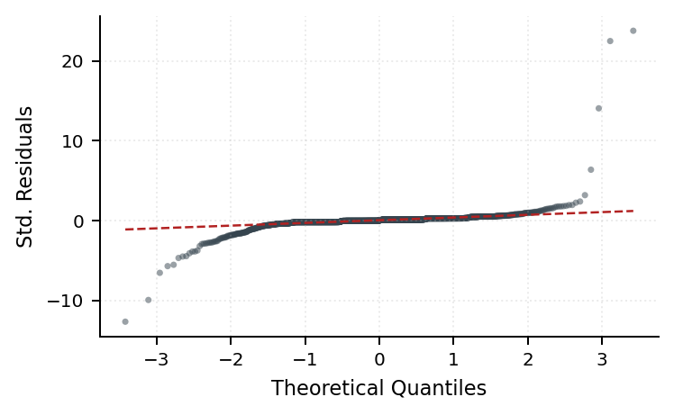
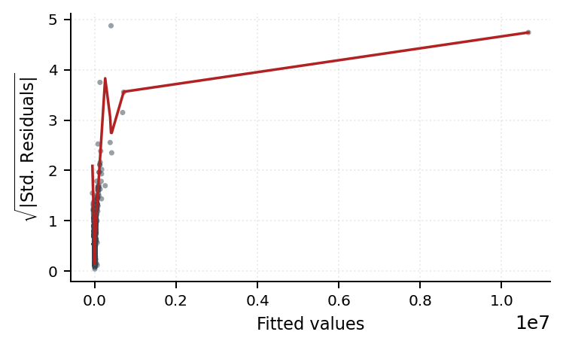
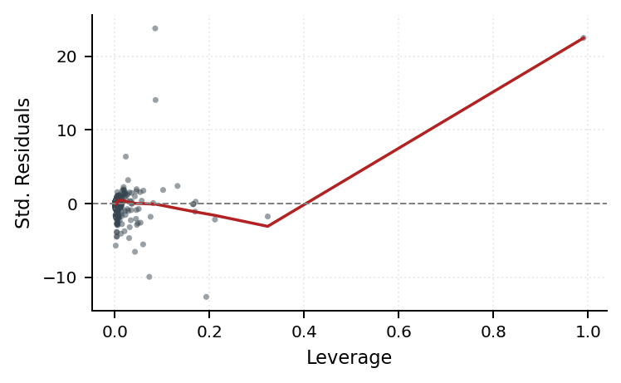
PHASE 1 · DIAGNOSTICS
07 / 13
The first fit breaks every assumption.
Before trusting any p-value, we check residuals. The default model fails on three counts — here's what each diagnostic plot is telling us.
NON-NORMALITY
OUTLIERS
The Q-Q plot shows massive deviation in both tails — the residuals are nowhere near normal. This destabilizes every confidence interval downstream.
Row 1198 sits at a leverage of 0.99 — a single point artificially inflating the model's R² to 0.99.
Residuals vs Fitted
Normal Q-Q
Scale-Location
Residuals vs Leverage
Shapiro-Wilk · p < 2.2e-16

Slide 8
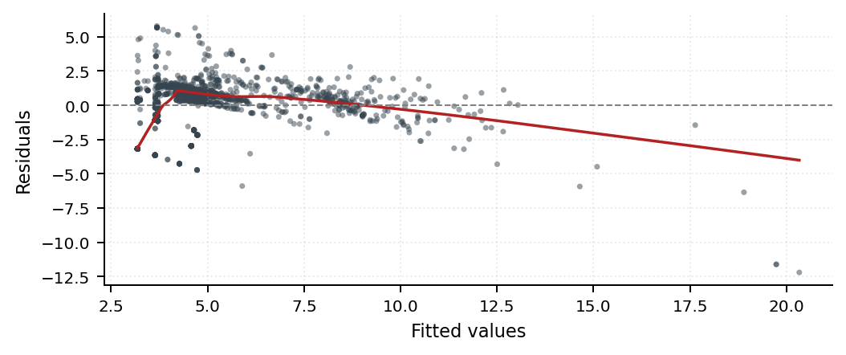
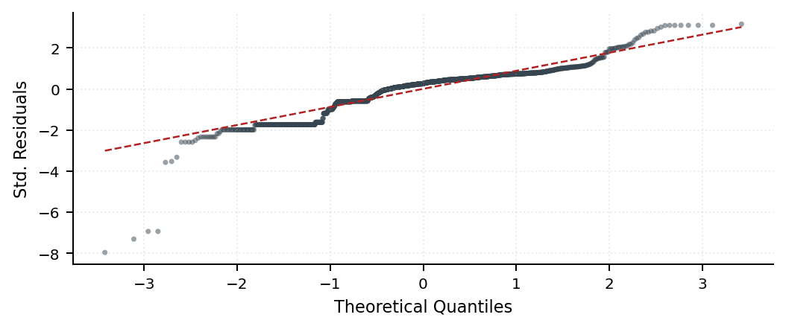
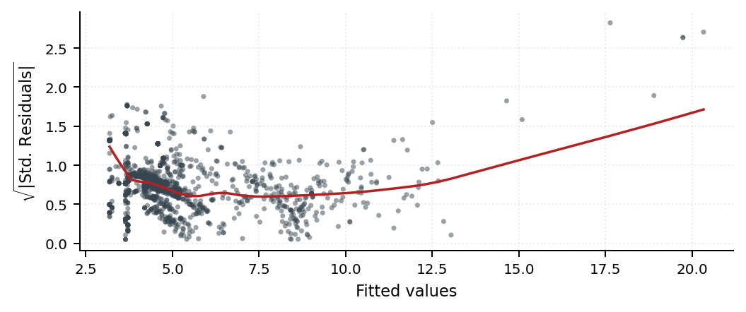
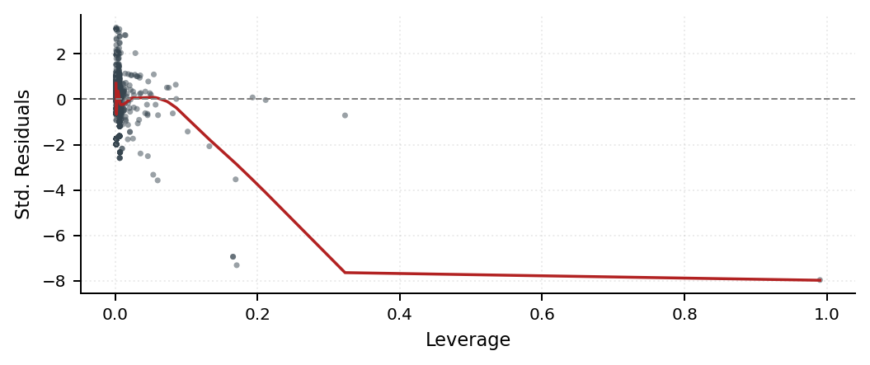
PHASE 1 · MODEL REPAIR
08 / 13
Two fixes restore the assumptions.
1
Outlier removal
2
Diagnostic robustness check
Pruned the single high-leverage point (Row 1198) that was inflating R² to 0.99 and warping the regression plane.
Refit with log1p(Flow.Bytes) as a variance check (plots below). Slide 9 keeps the raw-byte fit so coefficients stay interpretable.
Log · Residuals vs Fitted
Log · Normal Q-Q
SYNTHESIS
The Scale-Location plot flattens and the Q-Q line straightens — confirming the heavy-tailed structure. Slide 9 reports the raw-scale model after outlier removal, so coefficients stay in byte units.
Log · Scale-Location
Log · Residuals vs Leverage
STATISTICAL ANALYSIS OF CICIDS2017 INTRUSION DATA
STATISTICS II · MAY 2026

Slide 9
PHASE 1 · INTERPRETATION
09 / 13
What drives normal traffic volume?
R-SQUARED
OVERALL SIGNIFICANCE
PREDICTORS
0.6249
F = 333.35
8 / 8
A realistic fit after removing the leverage outlier.
F(8, 1601) · p < 2.2e-16
All retained predictors are statistically significant.
DOMINANT DRIVERS · PER 1-SD CHANGE
95% CONFIDENCE INTERVALS
DRIVER 1 · 1-SD INCREASE MOVES FLOW.BYTES BY 82.99% OF ITS SD
confint(mlr_model, level = 0.95 )
Avg.Bwd.Segment.Size
 | 2.5% | 97.5%
Intercept | -13,006.5 | -3,892.136
act_data_pkt_fwd | 1,671.243 | 1,991.878
PSH.Flag.Count | -9,793.332 | -2,656.97
Avg.Bwd.Segment.Size | 94.9016 | 113.2506
Bwd.Packet.Length.Std | -83.6379 | -63.8259
Bwd.Packet.Length.Min | -118.3284 | -87.5425
min_seg_size_forward | 96.1574 | 434.2465
Active.Std | -.0478 | -.0294
Active.Max | .0106 | .0155
82.99%
Larger average backward segment sizes are the strongest signal of higher byte volume.
DRIVER 2 · 1-SD INCREASE REDUCES FLOW.BYTES BY 58.41% OF ITS SD
Bwd.Packet.Length.Std
−58.41%
Greater variability in backward packet length predicts lower byte volume — irregular packet sizing breaks the normal-traffic baseline.
STATISTICAL ANALYSIS OF CICIDS2017 INTRUSION DATA
STATISTICS II · MAY 2026

Slide 10
PHASE 2 · LOGISTIC SETUP
10 / 13
Classifying threats from the baseline.
TARGET
DATA SPLIT
MODEL SCOPE
Attack_Flag
70 / 30
11 predictors
Binary outcome — 0 = benign, 1 = attack. Overall attack rate in the data is 19.3%.
Training · 1,397 rows
Testing · 600 rows
First-order terms only. Iterative stepwise BIC and VIF-based pruning. Max VIF: 4.37.
!
DIAGNOSTIC ALERT · PARTIAL SEPARATION
Active.Std, Fwd.Packet.Length.Min, and Avg.Fwd.Segment.Size were flagged for partial separation. We keep them for predictive accuracy but don't interpret their odds-ratio magnitudes.
STATISTICAL ANALYSIS OF CICIDS2017 INTRUSION DATA
STATISTICS II · MAY 2026

Slide 11
PHASE 2 · LOGISTIC SETUP
10 / 13
Variable explanation and model details.
GLM FORMULATION
$Y_{i}\sim Bin\left(1,p_{i}\right)$
$p_{i}=P(Y_{i}=1|X_{1i},…,X_{pi})$
$\log\left(\frac{p_{i}}{1−p_{i}}\right)=β_{0}+β_{1}x_{1i}+…+β_{p}x_{pi}$
Variable | Definition
Fwd.Packet.Length.Min | Smallest forward packet
Avg.Fwd.Segment.Size | Mean forward segment size
URG.Flag.Count | Number of packets with TCP URG flag set
Active.Std | Standard deviation of active periods
Down.Up.Ratio | The download and upload ratio
Destination.Port | Where traffic is going
Idle.Min | Shortest idle period
Avg.Bwd.Segment.Size | Mean backward segment size
Bwd.IAT.Total | Total inter-arrival time of backward packets
Init_Win_bytes_backward | Initial TCP receive window from server
PSH.Flag.Count | Number of packets with TCP PSH flag set
STATISTICAL ANALYSIS OF CICIDS2017 INTRUSION DATA
STATISTICS II · MAY 2026

Slide 12
PHASE 1 · INTERPRETATION
09 / 13
Logistic model results.
95% CONFIDENCE INTERVALS
WHAT’S SIGNIFICANT?
confint.default(final_model)
Fwd.Packet.Length.Min
Avg.Fwd.Segment.Size
URG.Flag.Count
Down.Up.Ratio
Avg.Bwd.Segment.Size
 | 2.5% | 97.5%
Fwd.Packet.Length.Min | -0.1768 | -0.0814
Avg.Fwd.Segment.Size | -0.1045 | -0.0603
URG.Flag.Count | -11.7455 | -4.6101
Active.Std | -20.3015 | 19.0991
Down.Up.Ratio | 0.9080 | 2.1326
Destination.Port | -0.0001 | 0
Idle.Min | 0 | 0
Avg.Bwd.Segment.Size | 0.0005 | 0.0016
Bwd.IAT.Total | 0 | 0
Init_Win_bytes_backward | -0.0001 | 0
PSH.Flag.Count | -0.6683 | 0.6383
STATISTICAL ANALYSIS OF CICIDS2017 INTRUSION DATA
STATISTICS II · MAY 2026

Slide 13
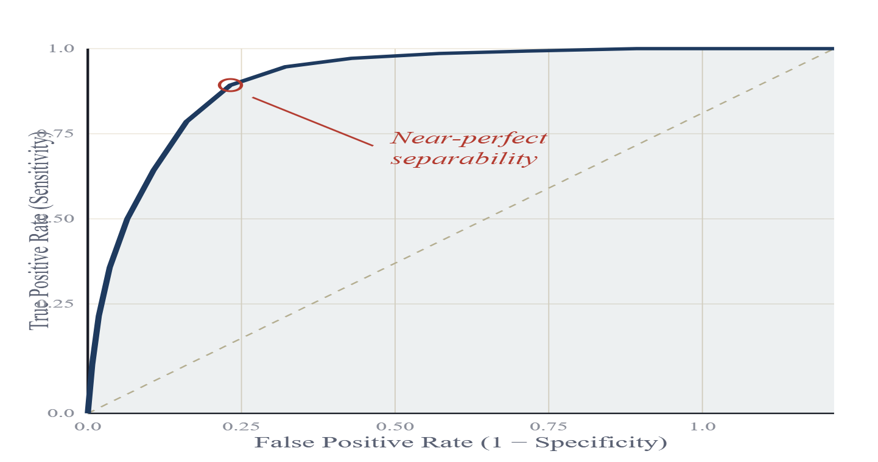
PHASE 2 · PERFORMANCE
11 / 13
The model catches attacks at near-perfect rates.
The overall model is highly significant — Likelihood Ratio Test χ² = 878.25, p = 2.94e-181.
ACCURACY
91.2%
ROC Curve
AUC = 0.9625
At a 0.5 probability cutoff — how often the model gets the call right overall.
SENSITIVITY
95.3%
Of all the true attacks in the data, the model successfully catches this many.
SPECIFICITY
89.0%
After tuning the threshold via Youden's Index — how often it correctly clears benign traffic.
A model that simply guesses would track the dashed diagonal. Ours hugs the top-left corner.
STATISTICAL ANALYSIS OF CICIDS2017 INTRUSION DATA
STATISTICS II · MAY 2026

Slide 14
PHASE 2 · COEFFICIENT INTERPRETATION
12 / 13
The anatomy of an attack.
To make the slopes practical, we measured the percentage change in the odds of an attack for every 1-standard-deviation increase in each predictor. The signs split cleanly in two directions.
High-risk signals · increase the odds
Protective signals · decrease the odds
Idle.Min
Fwd.Packet.Length.Min
+319.3% per 1-SD increase
95% CI [+178.4%, +562.8%] · p < 0.001
−100% unstable · separation-flagged
Down.Up.Ratio
Avg.Fwd.Segment.Size
+187.8% per 1-SD increase
95% CI [+96.2%, +325.7%] · p < 0.001
−100% unstable · separation-flagged
INTERPRETATION
Both predictors are flagged for separation (see slide 10) — odds ratios saturate at −100% because attacks rarely show normal forward packet sizes. Treat as a qualitative signal only.
INTERPRETATION
Attacks often feature prolonged idle states and asymmetric upload/download behavior — the fingerprint of automated, one-way traffic.
STATISTICAL ANALYSIS OF CICIDS2017 INTRUSION DATA
STATISTICS II · MAY 2026

Slide 15
CONCLUSIONS
13 / 13
Define normal — isolate the abnormal.
Phase 01
Phase 02
The Baseline
The Anomaly
MULTIPLE LINEAR REGRESSION
LOGISTIC REGRESSION
WHAT WE LEARNED
WHAT WE LEARNED
Normal traffic volume is highly predictable, driven primarily by base segment sizes ( Avg.Bwd.Segment.Size) and active data packets.
Malicious traffic deviates sharply from the baseline. It operates disproportionately on Registered Ports (44.4% attack rate) and shows anomalous timing (Idle.Min ) and asymmetric flow ( Down.Up.Ratio).
SYSTEMIC TRAIT
The data is inherently heavy-tailed and heteroscedastic — a log-transform was required before any baseline inference could be trusted.
SYSTEMIC TRAIT
These deviations let a first-order logistic model isolate attacks with 91.2% accuracy and an AUC of 0.9625.
By mathematically defining the shape of benign flow , anomalous network intrusions become statistically glaring — enabling highly sensitive ( 95.3%) automated detection.
STATISTICAL ANALYSIS OF CICIDS2017 INTRUSION DATA
STATISTICS II · MAY 2026

